Slide 1
Introduction to Quantum Algorithms
CS.49900 (Spring 2026)
Basic quantum Fourier transform, Deustch-Josza and Simon algorithms

Slide 2

Deutsch’s algorithm by phase oracle
Suppose we have a classical circuit $C:\left\{0,1\right\}→\{0,1\}$.
$C\left(0\right)=C(1)$ or $C\left(0\right)≠C\left(1\right)$?
Apply $H$ $H|0⟩$
Apply the phase circuit $P_{C}$ $P_{C}H\left|0\right\rangle$
Apply $H$ again ${HP}_{C}H\left|0\right\rangle$
Measure in the standard basis
1. Generate a uniform superposition
2. Compute the function in the phase
3. Make the interference between branches
4. Observe which kind of interference happens

Slide 3
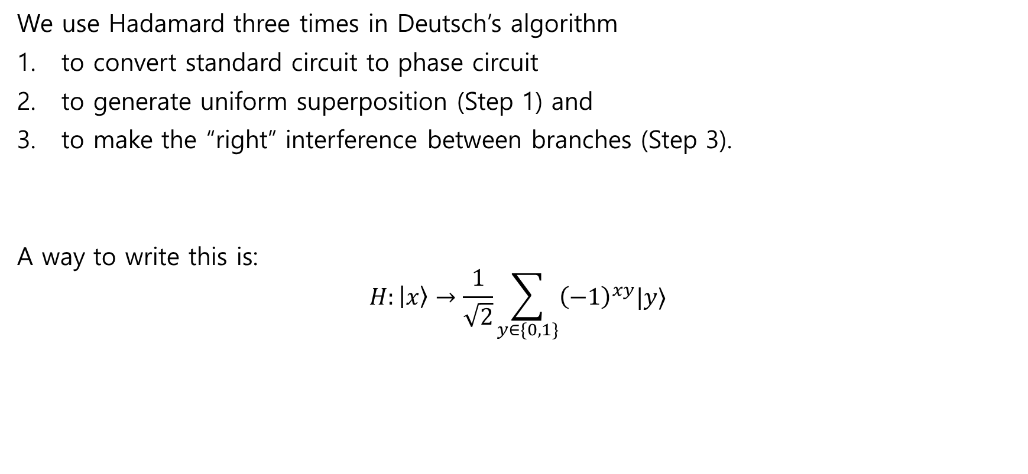
Use of Hadamard
We use Hadamard three times in Deutsch’s algorithm
to convert standard circuit to phase circuit
to generate uniform superposition (Step 1) and
to make the “right” interference between branches (Step 3).
A way to write this is:
$$H:\left|x\right\rangle →\frac{1}{\sqrt{2}}\sum_{y∈\{0,1\}}{{\left(−1\right)}^{xy}|y⟩}$$

Slide 4
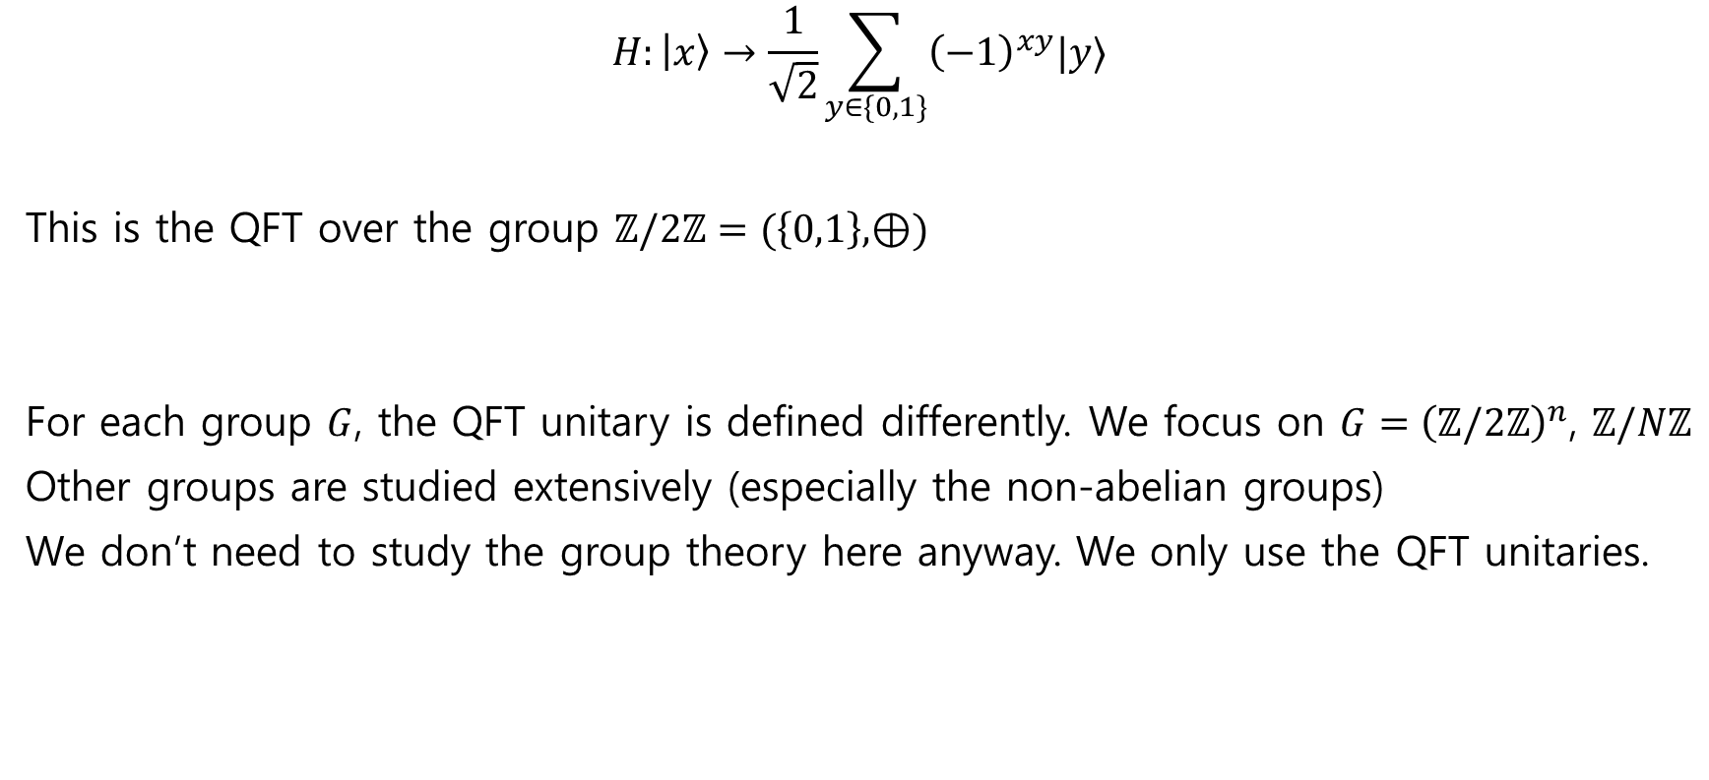
Quantum Fourier Transform (QFT)
$$H:\left|x\right\rangle →\frac{1}{\sqrt{2}}\sum_{y∈\{0,1\}}{{\left(−1\right)}^{xy}|y⟩}$$
This is the QFT over the group $ℤ/2ℤ=(\left\{0,1\right\},⊕)$
For each group $G$, the QFT unitary is defined differently. We focus on $G={\left(ℤ/2ℤ\right)}^{n}$, $ℤ/Nℤ$
Other groups are studied extensively (especially the non-abelian groups)
We don’t need to study the group theory here anyway. We only use the QFT unitaries.
advanced

Slide 5
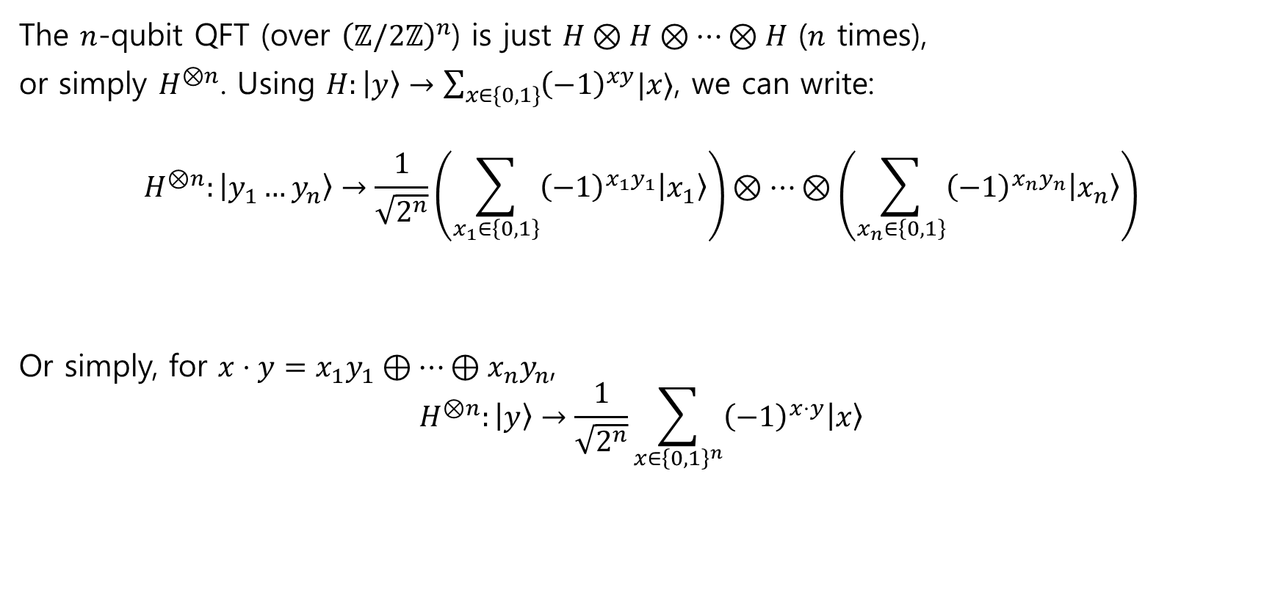
Quantum Fourier Transform (QFT)
The $n$-qubit QFT (over ${\left(ℤ/2ℤ\right)}^{n}$) is just $H⊗H⊗…⊗H$ ($n$ times),
or simply $H^{⊗n}$. Using $H:\left|y\right\rangle →\sum_{x∈\{0,1\}}{{\left(−1\right)}^{xy}|x⟩}$, we can write:
$$H^{⊗n}:\left|y_{1}…y_{n}\right\rangle →\frac{1}{\sqrt{2^{n}}}\left(\sum_{x_{1}∈\left\{0,1\right\}}{{\left(−1\right)}^{x_{1}y_{1}}\left|x_{1}\right\rangle }\right)⊗…⊗\left(\sum_{x_{n}∈\left\{0,1\right\}}{{\left(−1\right)}^{x_{n}y_{n}}\left|x_{n}\right\rangle }\right)$$
Or simply, for $x⋅y=x_{1}y_{1}⊕…⊕x_{n}y_{n}$,
$$H^{⊗n}:\left|y\right\rangle →\frac{1}{\sqrt{2^{n}}}\sum_{x∈{\left\{0,1\right\}}^{n}}{{\left(−1\right)}^{x⋅y}\left|x\right\rangle }$$

Slide 6

Some properties
Let use write
$$H^{⊗n}:\left|y\right\rangle →\frac{1}{\sqrt{2^{n}}}\sum_{x∈{\left\{0,1\right\}}^{n}}{{\left(−1\right)}^{x⋅y}\left|x\right\rangle }=|f_{y}⟩$$
As calculation exercises, we check on board:
$\left|f_{0}\right\rangle =\frac{1}{\sqrt{2^{n}}}\sum_{x∈{\left\{0,1\right\}}^{n}}{\left|x\right\rangle }$ is a uniform superposition of n-bit strings
$|f_{y}⟩$ is a unit vector
$\left\{\left|f_{y}\right\rangle :y∈{\left\{0,1\right\}}^{n}\right\}$ forms an orthonormal basis
$H^{⊗n}\left|f_{y}\right\rangle =|y⟩$

Slide 7
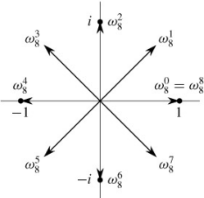

Why it is Fourier Transform?
We will later learn the following QFT over $ℤ/Nℤ$:
$$F_{N}:\left|x\right\rangle →\frac{1}{\sqrt{N}}\sum_{k=0}^{N−1}{ω_{N}^{kx}\left|k\right\rangle }$$
where $ω_{N}=\exp\left(2πi/N\right)$ is the $N$-th root of unity.
This exactly matches the (inverse) discrete Fourier transform
$$x_{j}=\frac{1}{N}\sum_{k=0}^{N−1}{ω_{N}^{kj}⋅X_{k}}$$

Slide 8
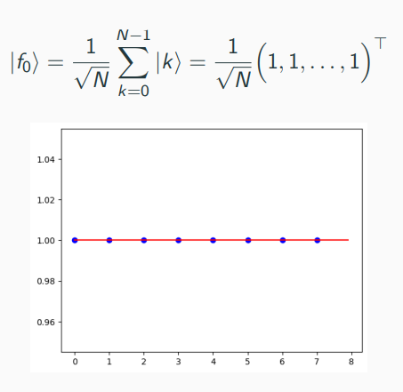
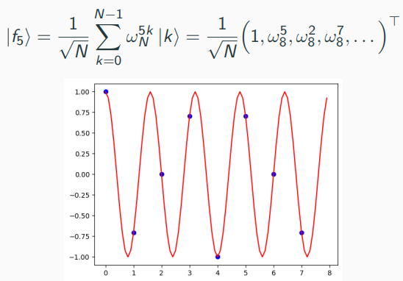
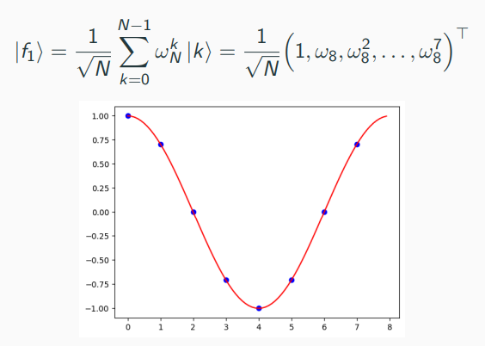
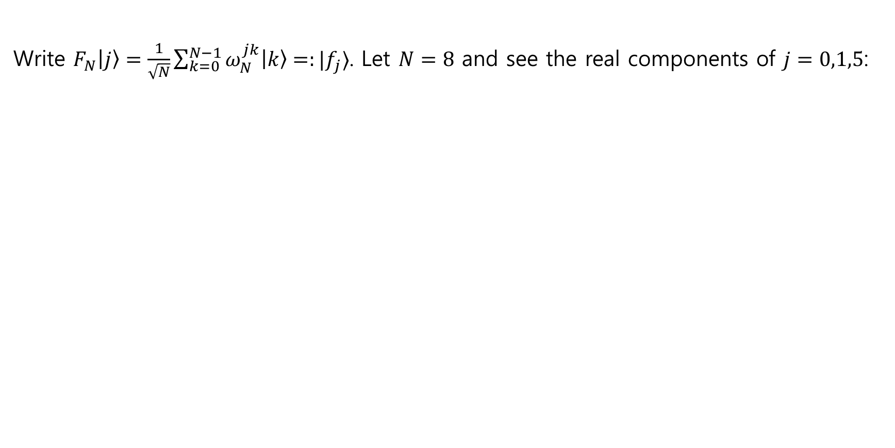
Why it is Fourier Transform?
Write $F_{N}\left|j\right\rangle =\frac{1}{\sqrt{N}}\sum_{k=0}^{N−1}{ω_{N}^{jk}\left|k\right\rangle =:|f_{j}⟩}$. Let $N=8$ and see the real components of $j=0,1,5$:

Slide 9



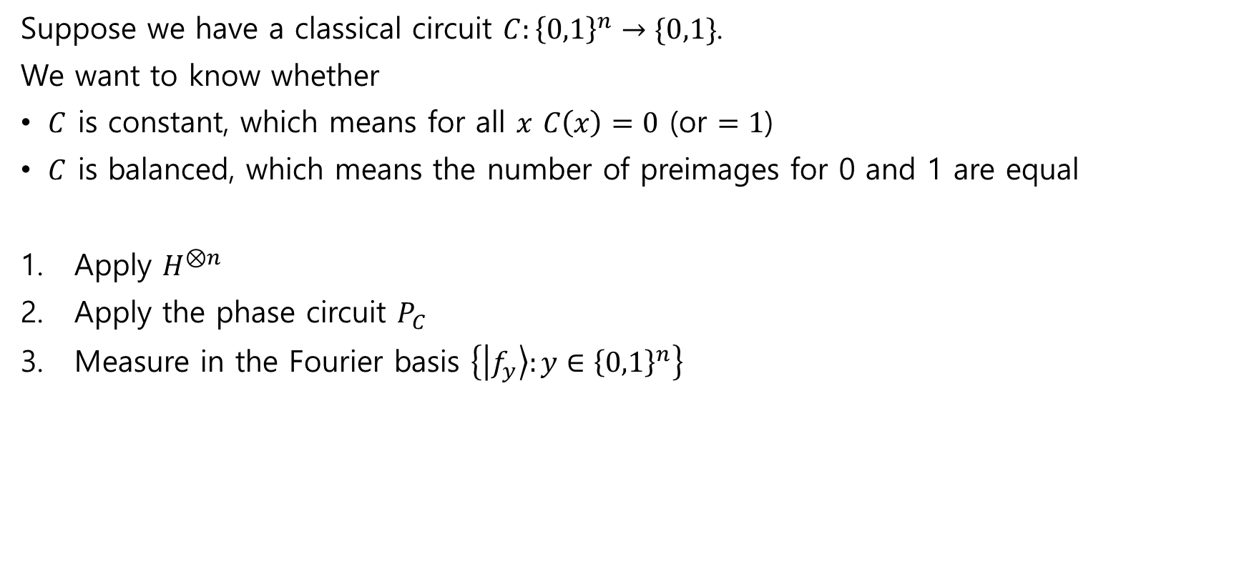


Deutsch-Jozsa algorithm
Suppose we have a classical circuit $C:{\left\{0,1\right\}}^{n}→\{0,1\}$.
We want to know whether
$C$ is constant, which means for all $x$ $C\left(x\right)=0$ (or $=1$)
$C$ is balanced, which means the number of preimages for 0 and 1 are equal
Apply $H^{⊗n}$
Apply the phase circuit $P_{C}$
Measure in the Fourier basis $\left\{\left|f_{y}\right\rangle :y∈{\left\{0,1\right\}}^{n}\right\}$
$$\left|0^{n}\right\rangle$$
$$H^{⊗n}$$
$$P_{C}$$
$$H^{⊗n}$$

Slide 10
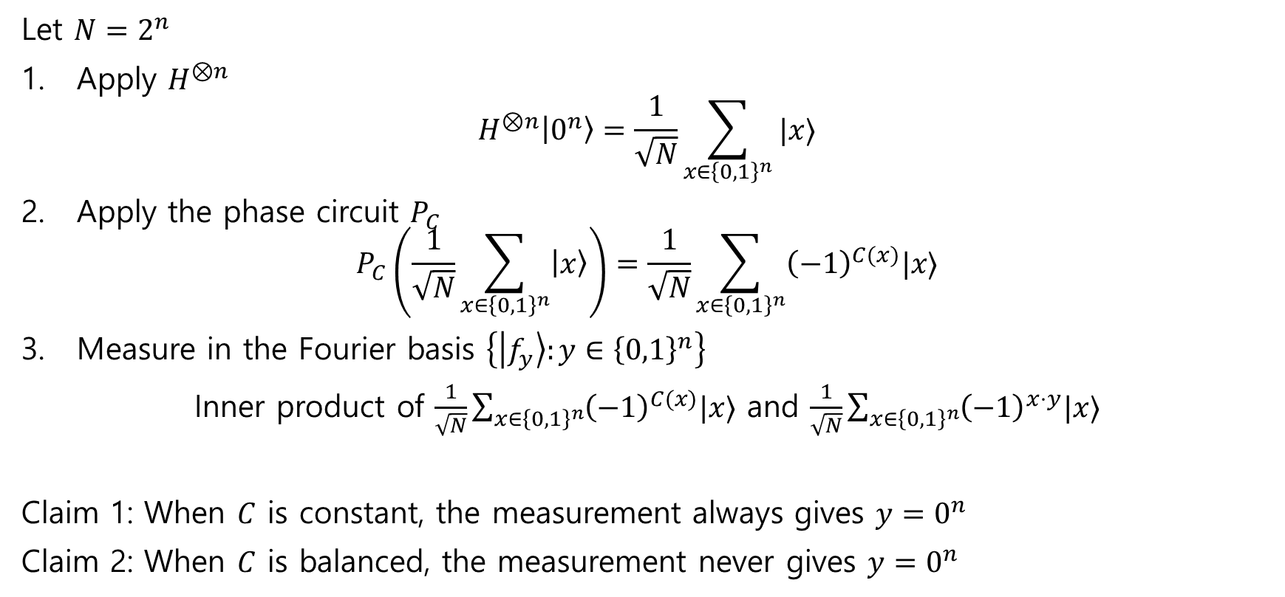
Analysis of Deutsch-Jozsa algorithm
Let $N=2^{n}$
Apply $H^{⊗n}$ $H^{⊗n}\left|0^{n}\right\rangle =\frac{1}{\sqrt{N}}\sum_{x∈{\left\{0,1\right\}}^{n}}{|x⟩}$
Apply the phase circuit $P_{C}$ $P_{C}\left(\frac{1}{\sqrt{N}}\sum_{x∈{\left\{0,1\right\}}^{n}}{\left|x\right\rangle }\right)=\frac{1}{\sqrt{N}}\sum_{x∈{\left\{0,1\right\}}^{n}}{{\left(−1\right)}^{C(x)}|x⟩}$
Measure in the Fourier basis $\left\{\left|f_{y}\right\rangle :y∈{\left\{0,1\right\}}^{n}\right\}$
Inner product of $\frac{1}{\sqrt{N}}\sum_{x∈{\left\{0,1\right\}}^{n}}{{\left(−1\right)}^{C(x)}|x⟩}$ and $\frac{1}{\sqrt{N}}\sum_{x∈{\left\{0,1\right\}}^{n}}{{\left(−1\right)}^{x⋅y}|x⟩}$
Claim 1: When $C$ is constant, the measurement always gives $y=0^{n}$
Claim 2: When $C$ is balanced, the measurement never gives $y=0^{n}$

Slide 11
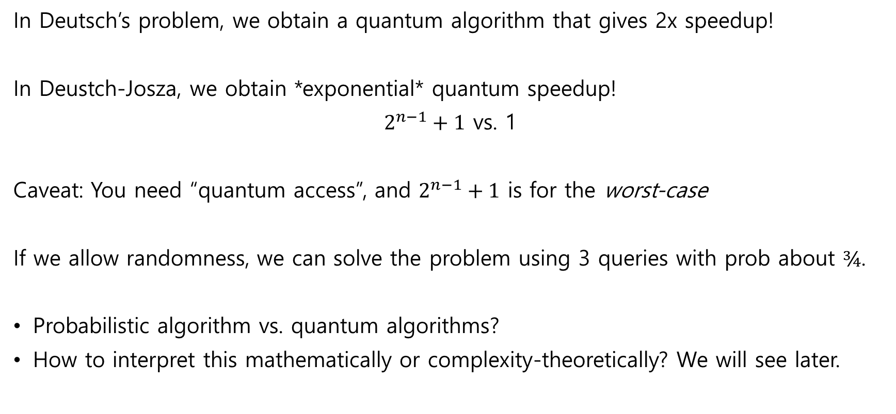
Deutsch and Deutsch-Josza, summary
In Deutsch’s problem, we obtain a quantum algorithm that gives 2x speedup!
In Deustch-Josza, we obtain *exponential* quantum speedup!
$2^{n−1}+1$ vs. 1
Caveat: You need “quantum access”, and $2^{n−1}+1$ is for the worst-case
If we allow randomness, we can solve the problem using 3 queries with prob about $¾$.
Probabilistic algorithm vs. quantum algorithms?
How to interpret this mathematically or complexity-theoretically? We will see later.

Slide 12

Simon’s Problem
Suppose we have a classical circuit $f:{\left\{0,1\right\}}^{n}→{\left\{0,1\right\}}^{n}$.
Promise:
$f$ has a hidden “order” $s$:
$$f\left(x\right)=f\left(y\right)⟺x=y⊕s$$
Q) Find the hidden string $s$
Quantumly we have $U_{f}\left|x,y\right\rangle =|x,y⊕f\left(x\right)⟩$ for $x,y∈{\left\{0,1\right\}}^{n}$

Slide 13

Simon’s Problem: Example
Example $f$:
What is $s$?
x | f(x)
000 | 101
001 | 010
010 | 000
011 | 110
100 | 000
101 | 110
110 | 101
111 | 010

Slide 14

Classical strategy
Set $t=2^{n/2}$
Randomly sample $x_{1},…,x_{t}∈{\left\{0,1\right\}}^{n}$
Check if there exists a pair $x_{i}≠x_{j}$ such that $f\left(x_{i}\right)=f(x_{j})$
If such a pair exists, we can conclude $s=x_{i}⊕x_{j}$
By the birthday paradox, we need $t$~$2^{n/2}$ queries to $f$
(Show on board)

Slide 15









Simon’s algorithm
This is a quantum-classical hybrid algorithm, with classical post-processing.
Main quantum subroutine:
$$\left|0^{n}\right\rangle$$
$$H^{⊗n}$$
$$U_{f}$$
$$H^{⊗n}$$
$$\left|0^{n}\right\rangle$$
$$\left|ψ_{1}\right\rangle$$
$$\left|ψ_{1}\right\rangle$$
$$\left|ψ_{2}\right\rangle$$
$$\left|ψ_{3}\right\rangle$$

Slide 16










Simon’s algorithm
$$\left|0^{n}\right\rangle$$
$$H^{⊗n}$$
$$U_{f}$$
$$H^{⊗n}$$
$$\left|ψ_{1}\right\rangle ={\left|+\right\rangle }^{⊗n}\left|0^{n}\right\rangle =\frac{1}{\sqrt{2^{n}}}\sum_{x∈{\left\{0,1\right\}}^{n}}{\left|x\right\rangle ⊗|0^{n}⟩}$$
$$\left|ψ_{2}\right\rangle =U_{f}{\left|+\right\rangle }^{⊗n}\left|0^{n}\right\rangle =\frac{1}{\sqrt{2^{n}}}\sum_{x∈{\left\{0,1\right\}}^{n}}{\left|x\right\rangle ⊗|f(x)⟩}$$
$$\left|0^{n}\right\rangle$$
$$\left|ψ_{1}\right\rangle$$
$$\left|ψ_{1}\right\rangle$$
$$\left|ψ_{2}\right\rangle$$
$$\left|ψ_{3}\right\rangle$$

Slide 17

Simon’s algorithm
$$\left|0^{n}\right\rangle$$
$$H^{⊗n}$$
$$U_{f}$$
$$H^{⊗n}$$
$$\left|ψ_{2}\right\rangle =U_{f}{\left|+\right\rangle }^{⊗n}\left|0^{n}\right\rangle =\frac{1}{\sqrt{2^{n}}}\sum_{x∈{\left\{0,1\right\}}^{n}}{\left|x\right\rangle ⊗|f(x)⟩}$$
If the measurement outcome: $y=f\left(x_{0}\right)=f(x_{1})$ for $x_{0}⊕s=x_{1}$, the post-measurement state is
$$\frac{1}{\sqrt{2}}\left(\left|x_{0}\right\rangle +|x_{1}⟩\right)\left|y\right\rangle$$
$$\left|0^{n}\right\rangle$$
$$\left|ψ_{1}\right\rangle$$
$$\left|ψ_{1}\right\rangle$$
$$\left|ψ_{2}\right\rangle$$
$$\left|ψ_{3}\right\rangle$$

Slide 18

Simon’s algorithm
$$\left|0^{n}\right\rangle$$
$$H^{⊗n}$$
$$U_{f}$$
$$H^{⊗n}$$
$$\frac{1}{\sqrt{2}}\left(\left|x_{0}\right\rangle +|x_{1}⟩\right)\left|y\right\rangle$$
for $x_{0}⊕s=x_{1}$.
Ignoring the second register (which is unentangled). Applying $H^{⊗n}$, we have…
(Analysis on board)
$$\left|0^{n}\right\rangle$$
$$\left|ψ_{1}\right\rangle$$
$$\left|ψ_{1}\right\rangle$$
$$\left|ψ_{2}\right\rangle$$
$$\left|ψ_{3}\right\rangle$$

Slide 19









Simon’s algorithm (without measurement)
$$\left|0^{n}\right\rangle$$
$$H^{⊗n}$$
$$U_{f}$$
$$H^{⊗n}$$
(Analysis on board?)
$$\left|0^{n}\right\rangle$$
$$\left|ψ_{1}\right\rangle$$
$$\left|ψ_{1}\right\rangle$$
$$\left|ψ_{2}\right\rangle$$
$$\left|ψ_{3}\right\rangle$$

Slide 20



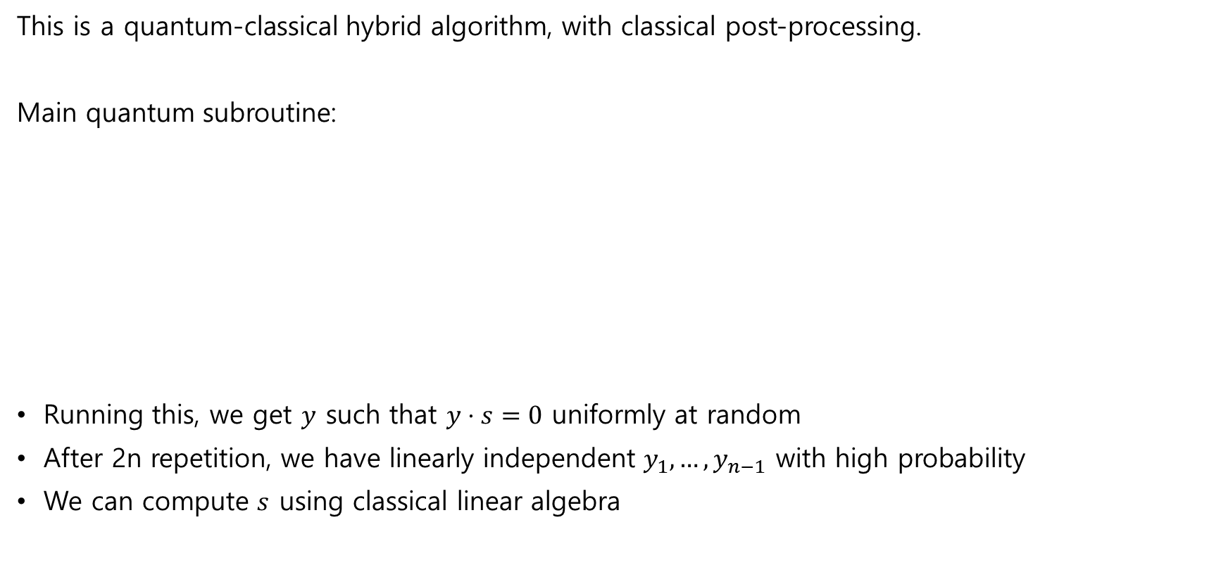






Simon’s algorithm
This is a quantum-classical hybrid algorithm, with classical post-processing.
Main quantum subroutine:
Running this, we get $y$ such that $y⋅s=0$ uniformly at random
After 2n repetition, we have linearly independent $y_{1},…,y_{n−1}$ with high probability
We can compute $s$ using classical linear algebra
$$\left|0^{n}\right\rangle$$
$$H^{⊗n}$$
$$U_{f}$$
$$H^{⊗n}$$
$$\left|0^{n}\right\rangle$$
$$\left|ψ_{1}\right\rangle$$
$$\left|ψ_{1}\right\rangle$$
$$\left|ψ_{2}\right\rangle$$
$$\left|ψ_{3}\right\rangle$$

Slide 21
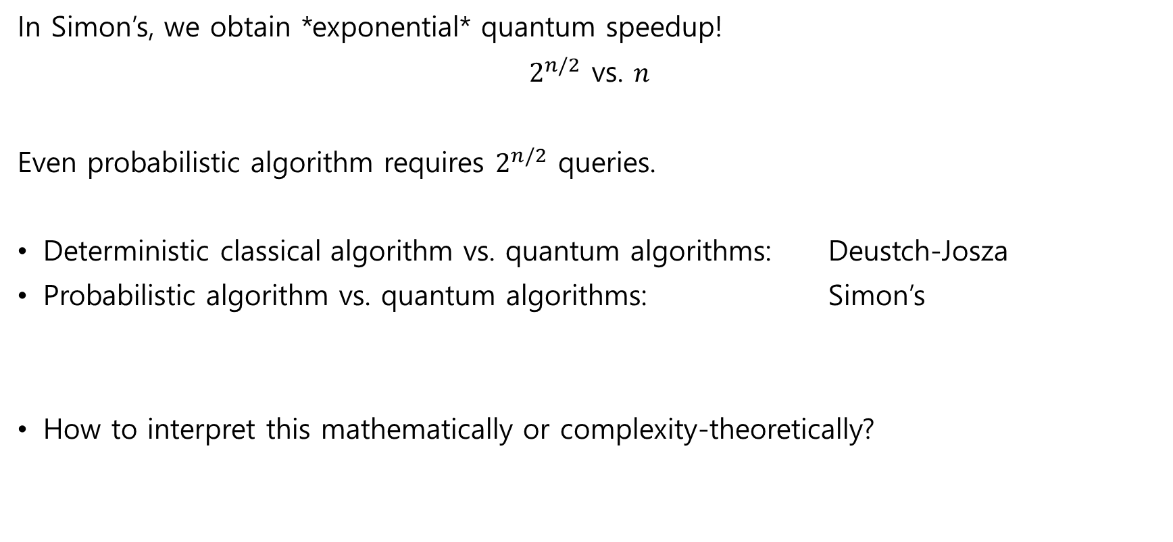
Simon’s problem, summary
In Simon’s, we obtain *exponential* quantum speedup!
$2^{n/2}$ vs. $n$
Even probabilistic algorithm requires $2^{n/2}$ queries.
Deterministic classical algorithm vs. quantum algorithms: Deustch-Josza
Probabilistic algorithm vs. quantum algorithms: Simon’s
How to interpret this mathematically or complexity-theoretically?

